Slide 1
Data

Slide 2
Agenda
Data and Data Types
Data Quality
Data Preprocessing
Similarity & Dissimilarity
Data Exploration and Visualisation

Slide 3
What is Data
Data is a raw data
Data is a collection of objects defined by attributes
An attribute is a property or characteristic of an object
Education of the person
Country of origin
The collection of properties defines an object (record, instant, record)

Slide 4
What is Data
A data set is a collection of records (instants)
Record is a collection of attributes
Fields
Columns
Values

Slide 5
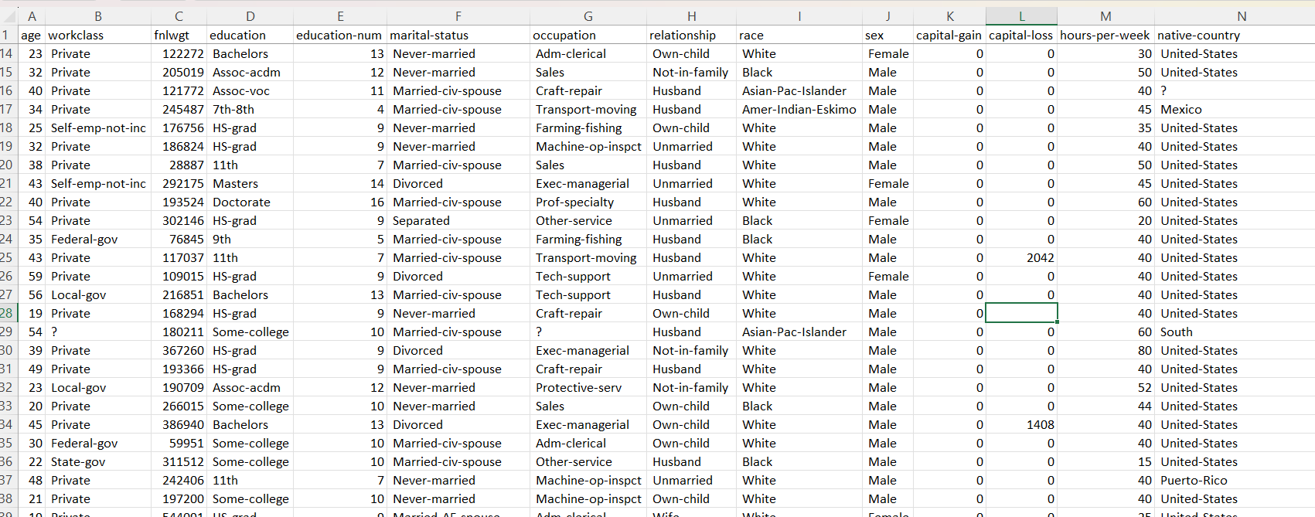
Attributes - column

Slide 6
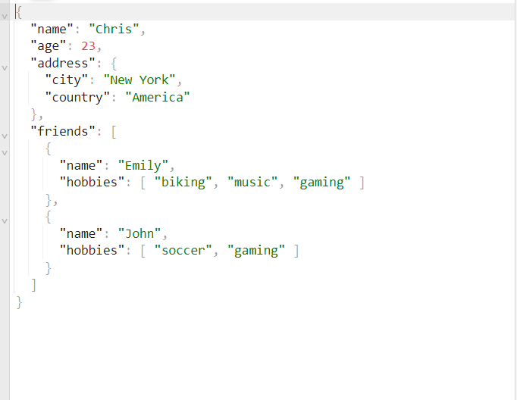
Attributes –fields or values
JSON Example

Slide 7
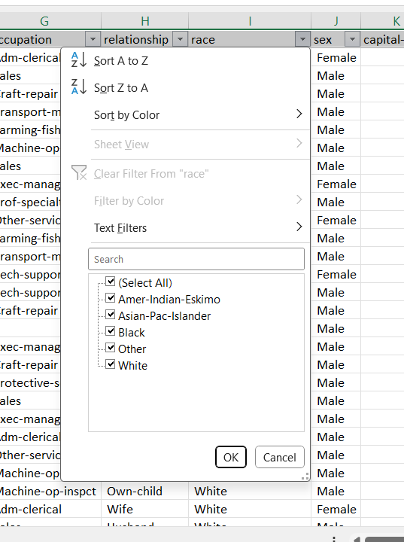
Attributes
The set of values that the object consists of
Categorical
Numeric
Strings

Slide 8
Attributes
Discreet Values – a countably infinite set of values, that can be counted number
Postal Code
Number of flowers
Often represented as an integer, can be represented as binary
Continues attributes – numeric values (represented with float value)
Temperature (10.7C)
Currency

Slide 9
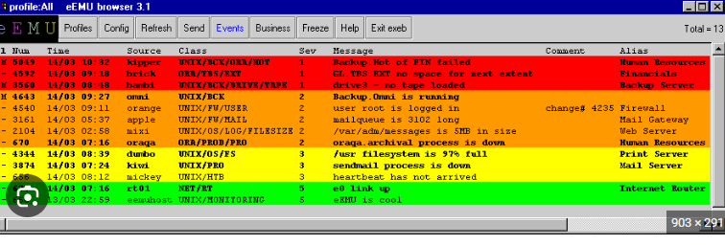
Attributes
Categorical Values
Define set - Gender, Marital Status
Ordinal / Categorical – Ranking

Slide 10
Attributes
Categorical Values
Define set - Gender, Marital Status
Ordinal / Categorical – Ranking

Slide 11
Attributes
Interval
Temperature
Thresholds
Salary Ranges
Ratio
Distance (length)
Time

Slide 12
Data Sets

Slide 13
Data Sets
Record
Transactional – retail store financial institution
Document
Matrix
Ordered
Special – google map
Sequential – yahoo stocks

Slide 14
Data Sets
Graphs
Word Wide Web
Network Infrastructure

Slide 15
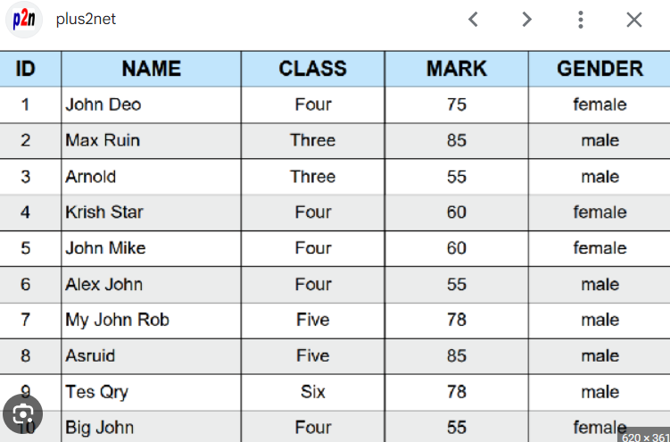
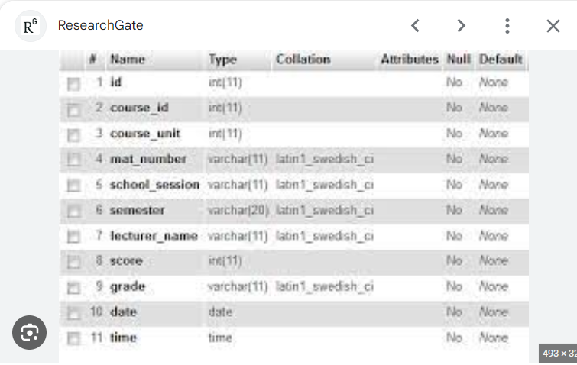
Relation Data Set

Slide 16
List of Relation DB
Mysql /PostSql / Sql Light / MariaDB
Microsoft Azure SQL Database / Amazon Aurora / Amazon redshift
Microsoft SQL Server
Oracle
InfiniDB - very quick in loading data, built for big data
Hive – Apache Hive data warehouse built on Hadoop

Slide 17
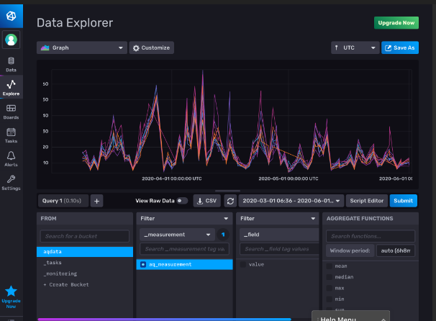
Time series databases
InfluxDB
Prometheus
Apache Casandra
Redish
Time Series

Slide 18
Data Quality

Slide 19
Questions should be asked
What problems should we worry about?
How can we detect problems with the data?
What can we do about the problem?
Very Common problems
Missing Values
Noise
Duplicate Values

Slide 20
Noise
Invalid signal that overlaps valid data
Distortion of a signal during the phone call
“Snow ” during the TV show
In accurate value in the column
Inconsistency in data
Human errors

Slide 21
Noise
Invalid signal that overlaps valid data
Distortion of a signal during the phone call
“Snow ” during the TV show
In accurate value in the column
Inconsistency in data
Human errors

Slide 22
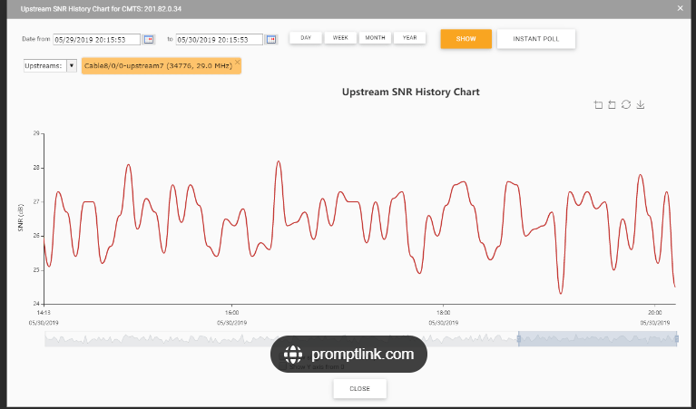
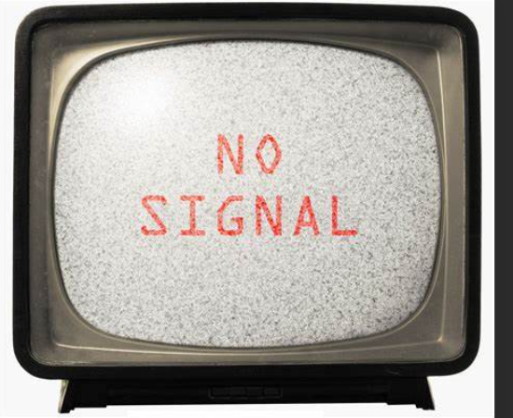
Noise

Slide 23
Outliers
Data points with characteristics that are considerably different than most of the other data in the data set
Outliers are a valid data
Data was collected properly

Slide 24
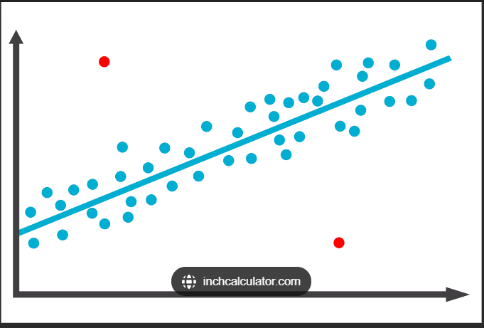
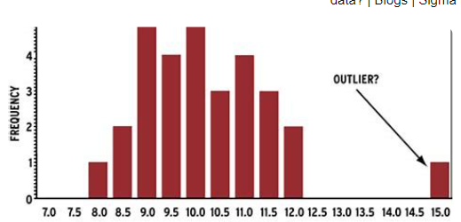
Outliers

Slide 25
Missing Values
Information is not collected
Data was not recorded
Device error (Hardware error)
Transfer Error
Human / Script error
Information was not inputted properly

Slide 26
Handling Missing values
Remove record with missing values
Replace missing values by using
Algorithms
Statistics calculations
Ignore Missing values

